Slide 1
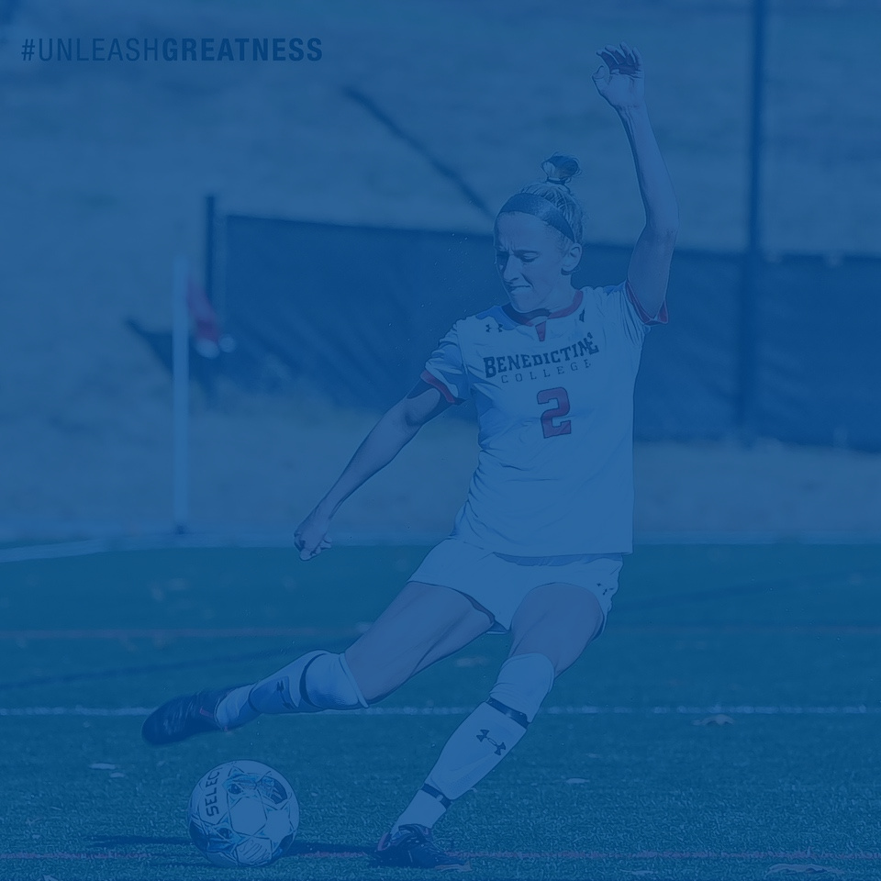


CHAMPIONS OF CHARACTER
Character Driven Athletics

Slide 2

THE VALUE OF CHAMPIONS OF CHARACTER

Slide 3
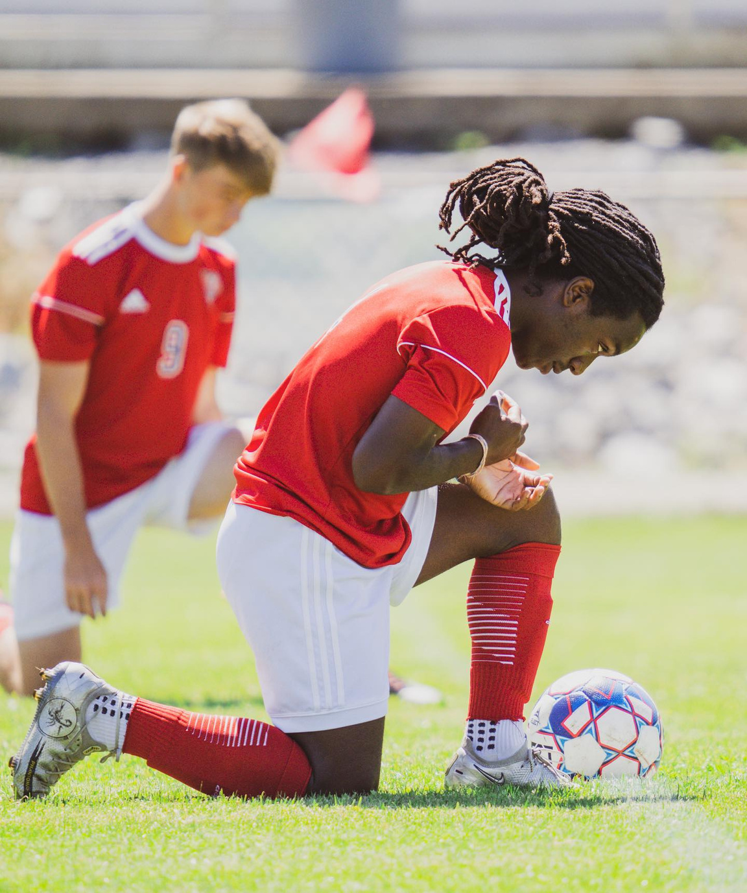

WHY IS CHAMPIONS OF CHARACTER IMPORTANT?
Notes:
The vision of National Association of Intercollegiate Athletics (NAIA) Champions of Character program is to change the culture of sport. Its mission is to provide training to instill the values that build character so students, coaches and parents know, do and value the right thing on and off the field.
The NAIA is the only athletic association committed to
“Character-driven Athletics”

Slide 4
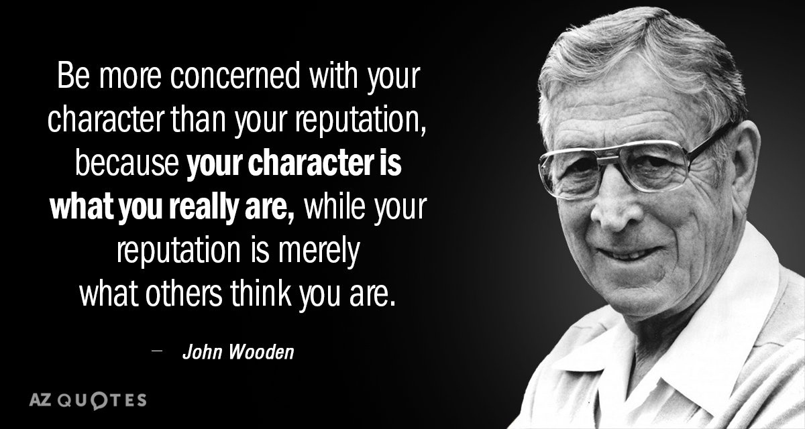


Be more concerned with your character than your reputation because your character is what you really are, while your reputation is merely what others think you are.
JOHN WOODEN
Notes:
In 1947, Wooden and the Indiana State Sycamores won the conference title and received an invitation to the NAIB, now the NAIA, national tournament at Municipal Auditorium in Kansas City, Missouri. Wooden refused the invitation citing the policy that banned African American players from competing. Wooden declined to compete if a member of his squad, Clarence Walker, was not allowed to participate. The following year, the NAIB changed its policy, and Wooden with Walker, guided the Sycamores to the national championship game losing to Louisville, 82-70.
Perhaps his actions opened the door for Tennessee State and Coach John McLendon to win the first of three consecutive national championships in years to follow. Wooden's involvement in breaking the color barrier in college athletics, and his story in doing so, signified his principles as a human being. Although his coaching career in the NAIA was limited to two years, his contribution and stance for justice remains a cornerstone of the NAIA legacy.

Slide 5
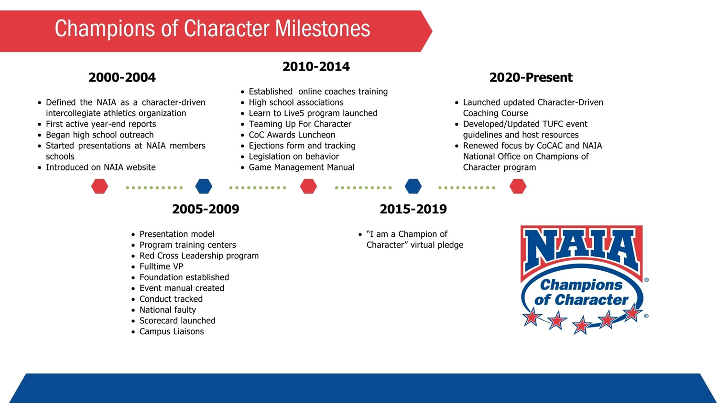

COC TIMELINE

Slide 6
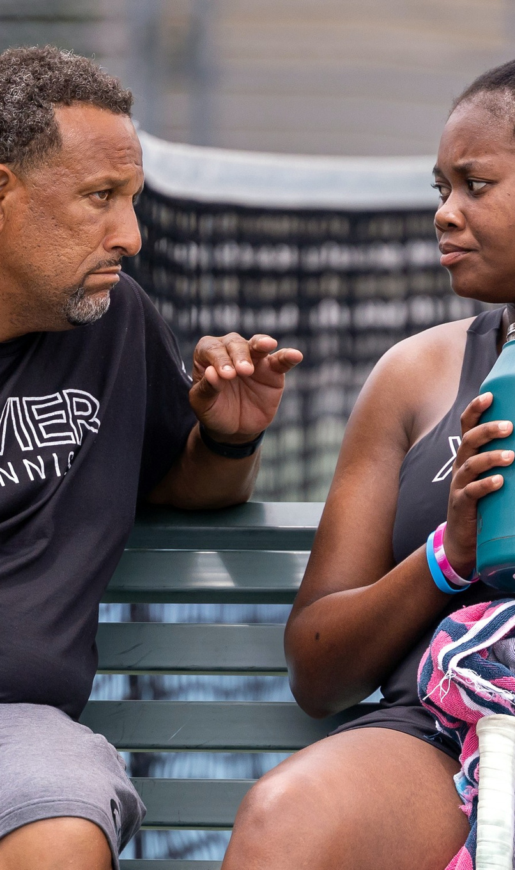
1
INTEGRITY
2
RESPECT
5 CORE VALUES
3
RESPONSIBILITY
4
SPORTSMANSHIP
5
SERVANT LEADERSHIP
Notes:
The Champions of Character program helps participants find the balance by keeping five core values – integrity, respect, responsibility, sportsmanship, and servant leadership – at the heart of the athletics experience.
For more than two decades, Champions of Character has been making a difference in developing athletes, coaches and parents of character.

Slide 7
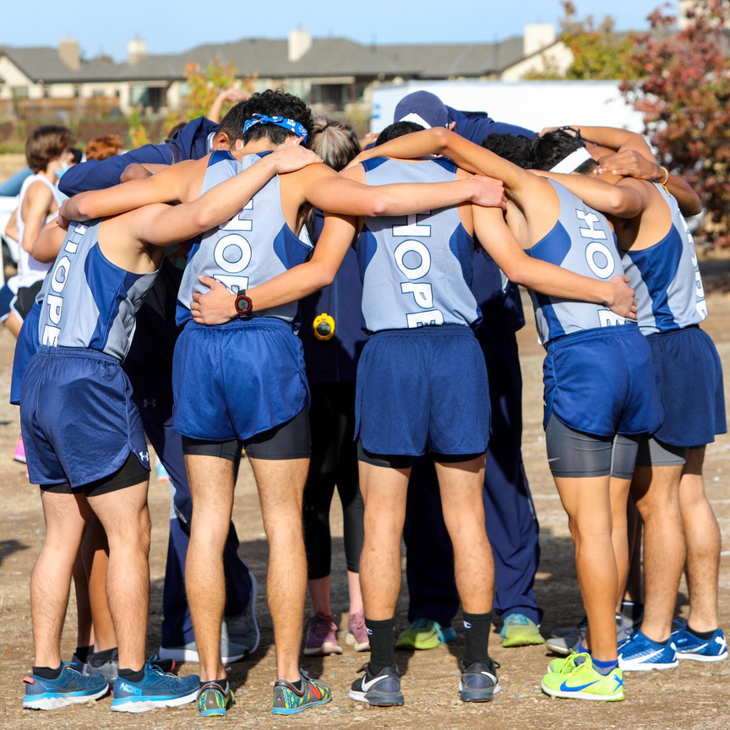
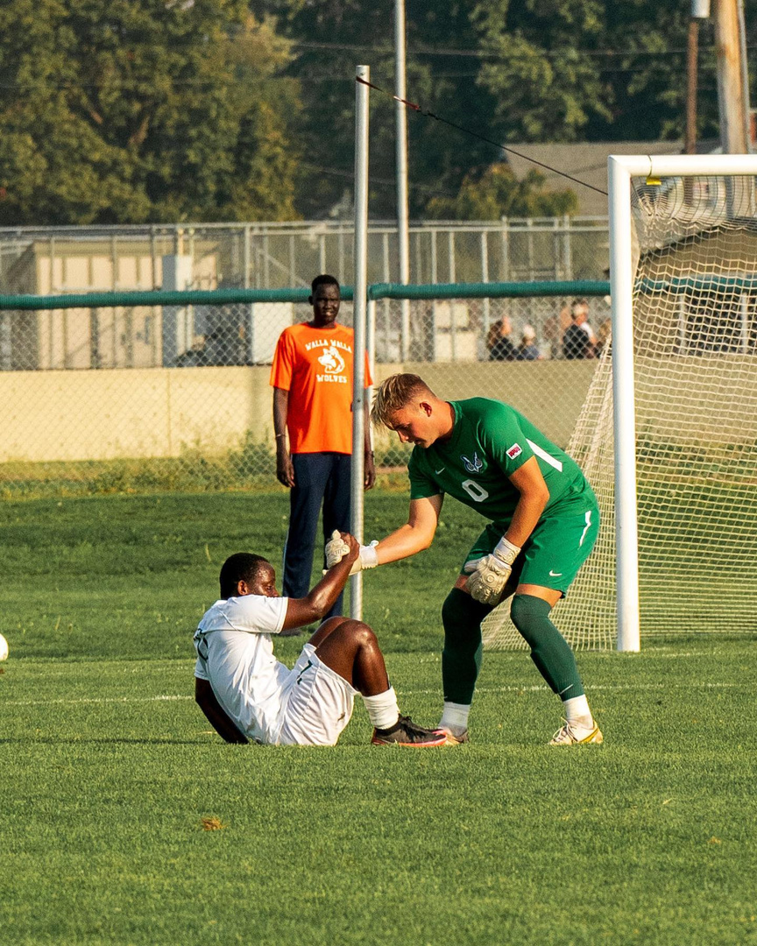
INTEGRITY
Know and Do What Is Right
BE COMMITTED
BE COURAGEOUS
BE HONEST
BE DISCIPLINED
BE RESILIENT
Notes:
Ask SA provide examples of integrity; challenge them and ask for examples of integrity outside of athletics. What does it look like off the field?
Integrity is a choice of behaviors displayed in small daily decisions. Athletes have actions that follow their words and beliefs. Their yes means yes and no means no. Their word is good, their handshake confirms the deal and their signature is worth something. They are worthy of respect. The first step to building a successful team is surrounding yourself with people of integrity. Integrity is a simple concept. For the person of integrity life may not be any easier, but it is simpler. It is not always easy to do what is ethically correct, but it is simple to know which path is most ethical and then exercise that option.

Slide 8
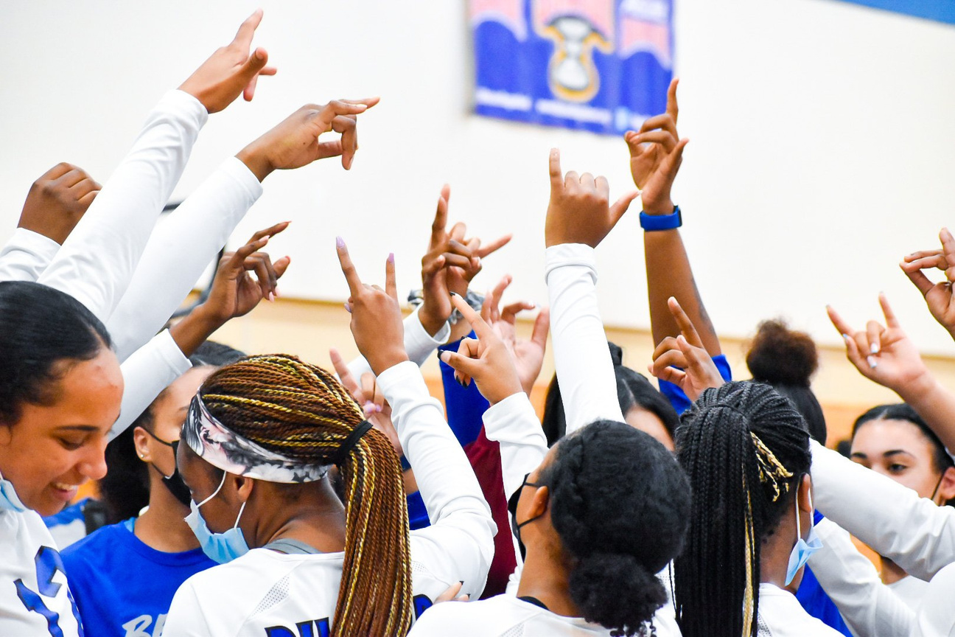
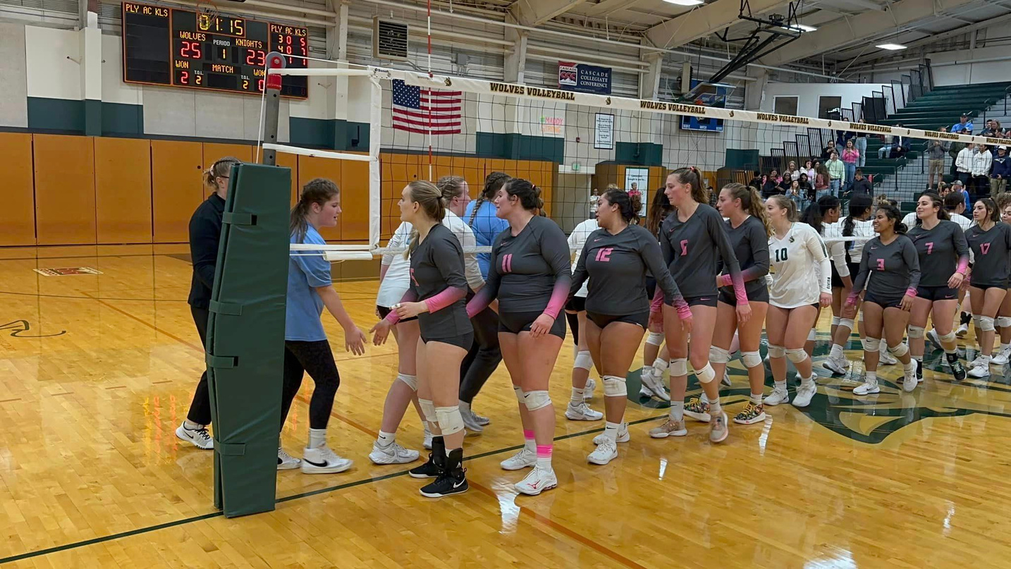
RESPECT
Treating Others The Way You Want To Be Treated
BE ACCEPTING
BE CONSIDERATE
BE ATTENTIVE
BE ENCOURAGING
BE APPRECIATIVE
Notes:
Ask SA provide examples of respect; challenge them and ask for examples of respect outside of athletics. What does it look like off the field?
Athletes are to be accountable. Accountability is demonstrated by taking responsibility and action for whatever happens to you, and builds trust between teammates. An athlete becomes known for being reliable and someone people can count on when it comes to work that must be performed. Reliability is developed from daily work habits.

Slide 9
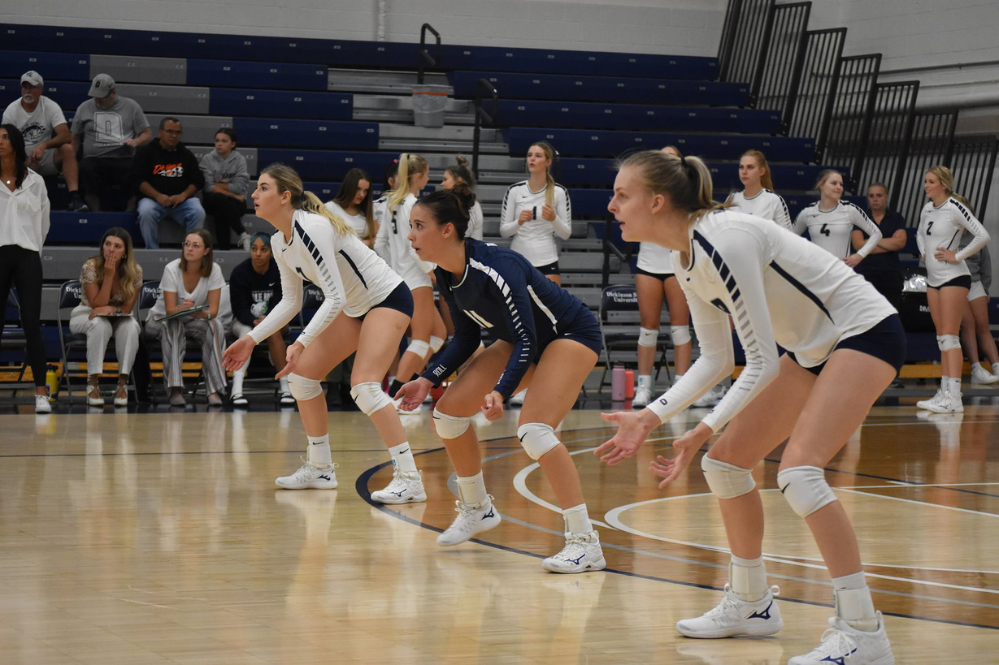
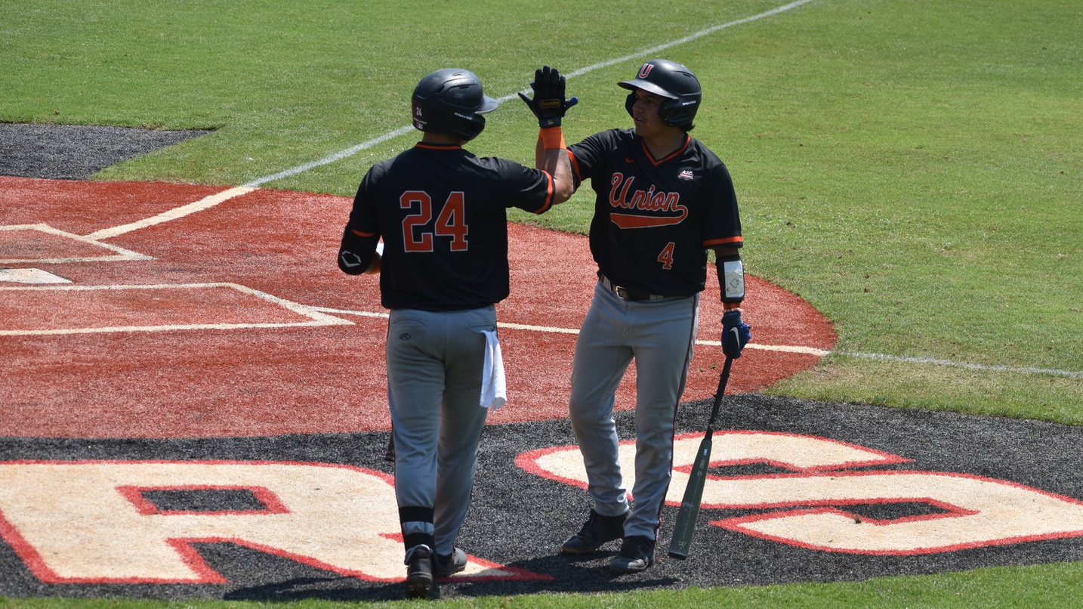
RESPONSIBILITY
Embrace Opportunities to Contribute
BE HELPFUL
BE CONSCIENTIOUS
BE ACCOUNTABLE
BE PERSEVERING
BE RELIABLE
Notes:
Ask SA provide examples of responsibility; challenge them and ask for examples of responsibility outside of athletics. What does it look like off the field?

Slide 10
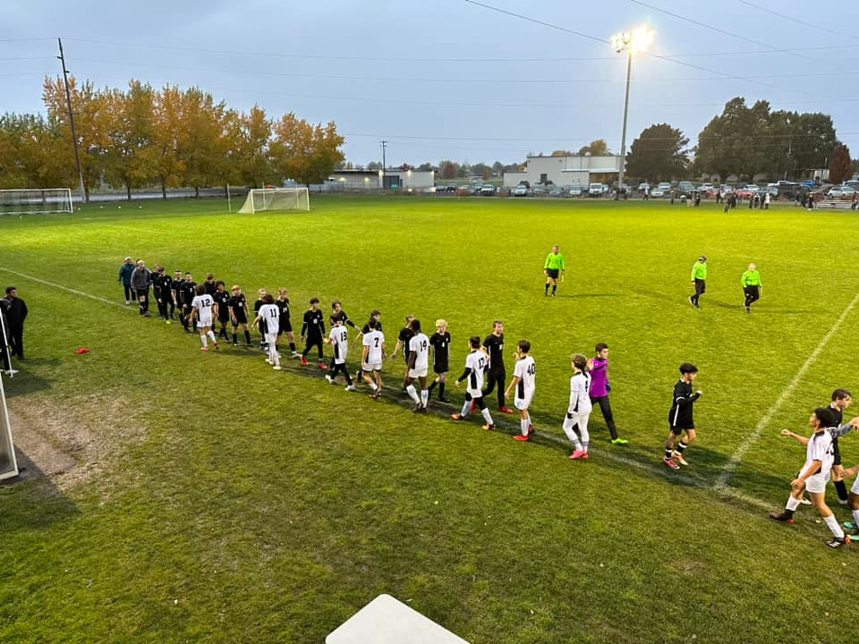
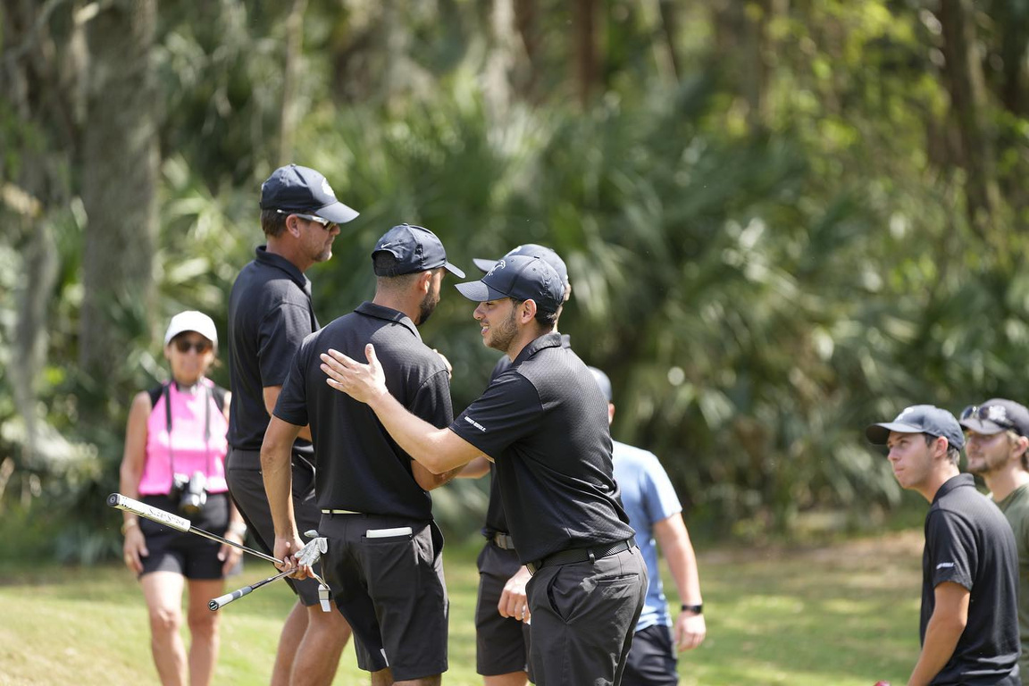
SPORTSMANSHIP
Bring Your Best To All Commpetition
BE COOPERATIVE
BE FAIR
BE GRACIOUS
BE HONORABLE
BE HUMBLE
Notes:
Ask SA provide examples of sportsmanship; challenge them and ask for examples of sportsmanship outside of athletics. What does it look like off the field?
An athlete of character understands and can model sportsmanship. Sportsmanship is a concrete measure of your understanding of and commitment to fair play, ethical behavior and integrity – spirit of benevolence and genuine consideration for others. Sportsmanship is not a passive activity of acceptance. Rather, it is a positive reaffirmation of the fact that an athlete is disciplined enough to have perspective, maintain poise and do what is best for his or her teammates.

Slide 11

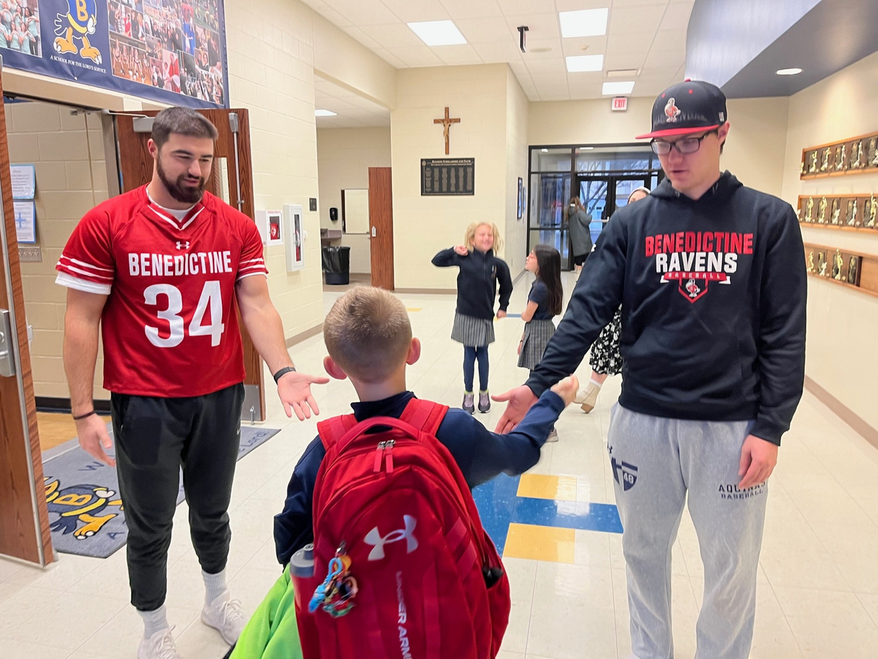
SERVANT
LEADERSHIP
Serve the Common Good
BE EMPOWERING
BE VISIONARY
BE INTERCONNECTED
BE GENEROUS
BE ENERGETIC
Notes:
Ask SA provide examples of servant leadership; challenge them and ask for examples of servant leadership outside of athletics. What does it look like off the field?
An athlete of character understands and can demonstrate a “team-first attitude.” Athletes in leadership positions understand and can model servant leadership. These athletes always put the needs of the team ahead of their own. Being part of a team involves an intentional step from independence (me first) to interdependence (we first). One of the best examples of being a “wefirst” teammate is when a player accepts a role on a team.

Slide 12
CHAMPION OF CHARACTER PROGRAMS/COMPONENTS
CoC Liaison
Character Recognition
Teaming Up For Character
Coach of Character Training
Conduct in Competition

Slide 13
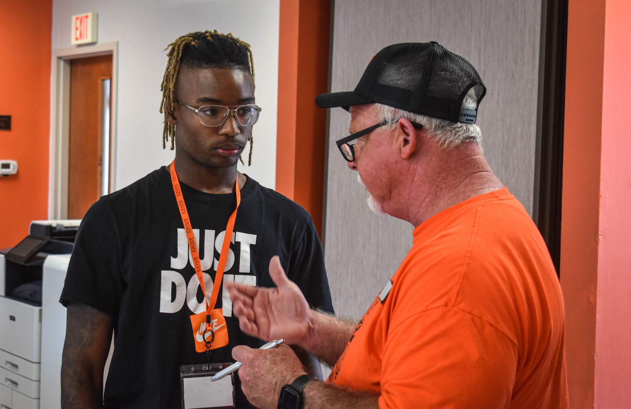
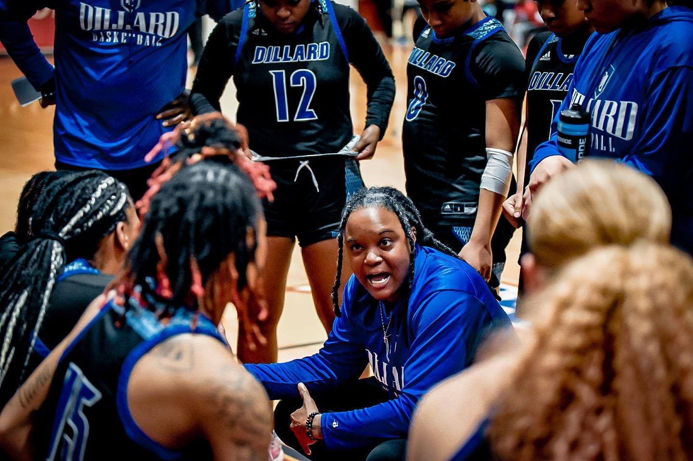
COC LIAISON
  Each NAIA institution designates one or more individuals as the Champions of Character Liaison
  Oversees all COC efforts on campus
  Dedicated to promoting and educating around Champions of Character
Notes:
Each NAIA institution has a Champions of Character® Liaison who implements the program. Make sure to name and identify your campus CofC Liaison for the group.
1) Character Education: Professional Development
2) Hospitality and Game Management: Conduct in Competition
3) Share the Character Message
4) Promote and Recognize Character: Awards and Recognition
5) Oversight and Assessment

Slide 14
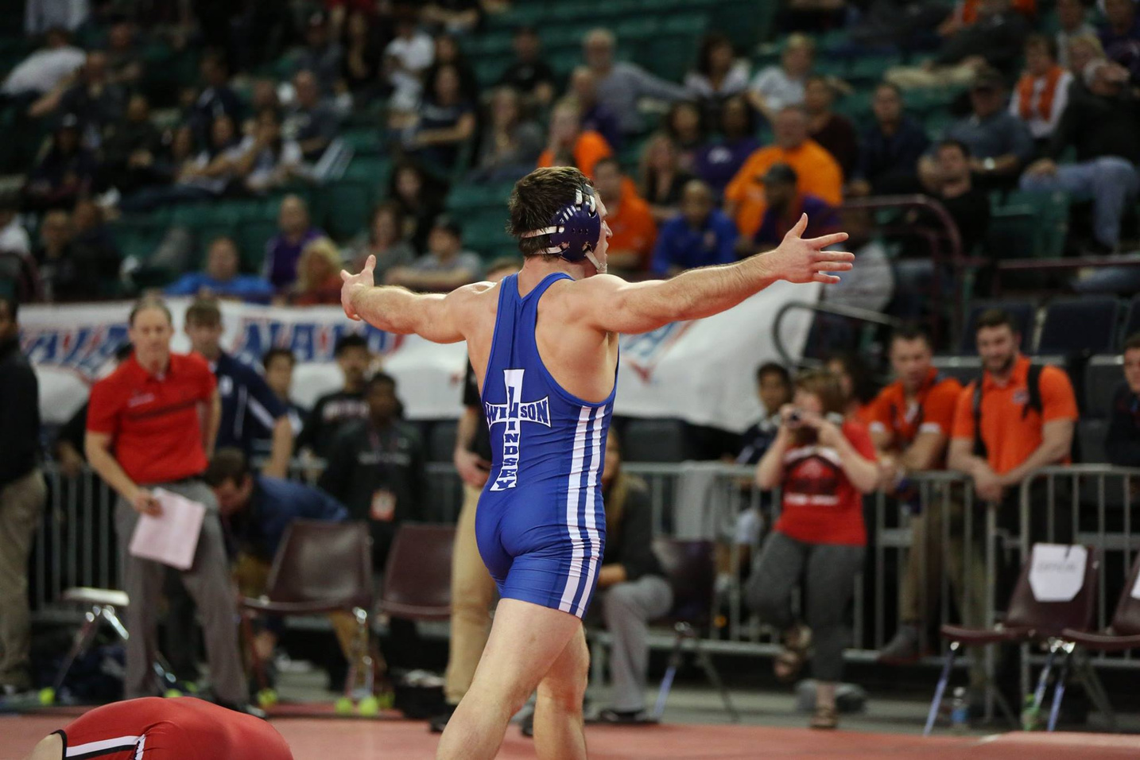
CHARACTER RECOGNITION
Awards and Scholarships
  Promote and Recognize Character
  Coach of Character Award
  Dr. Leroy Walker Champions of Character Awards

Slide 15
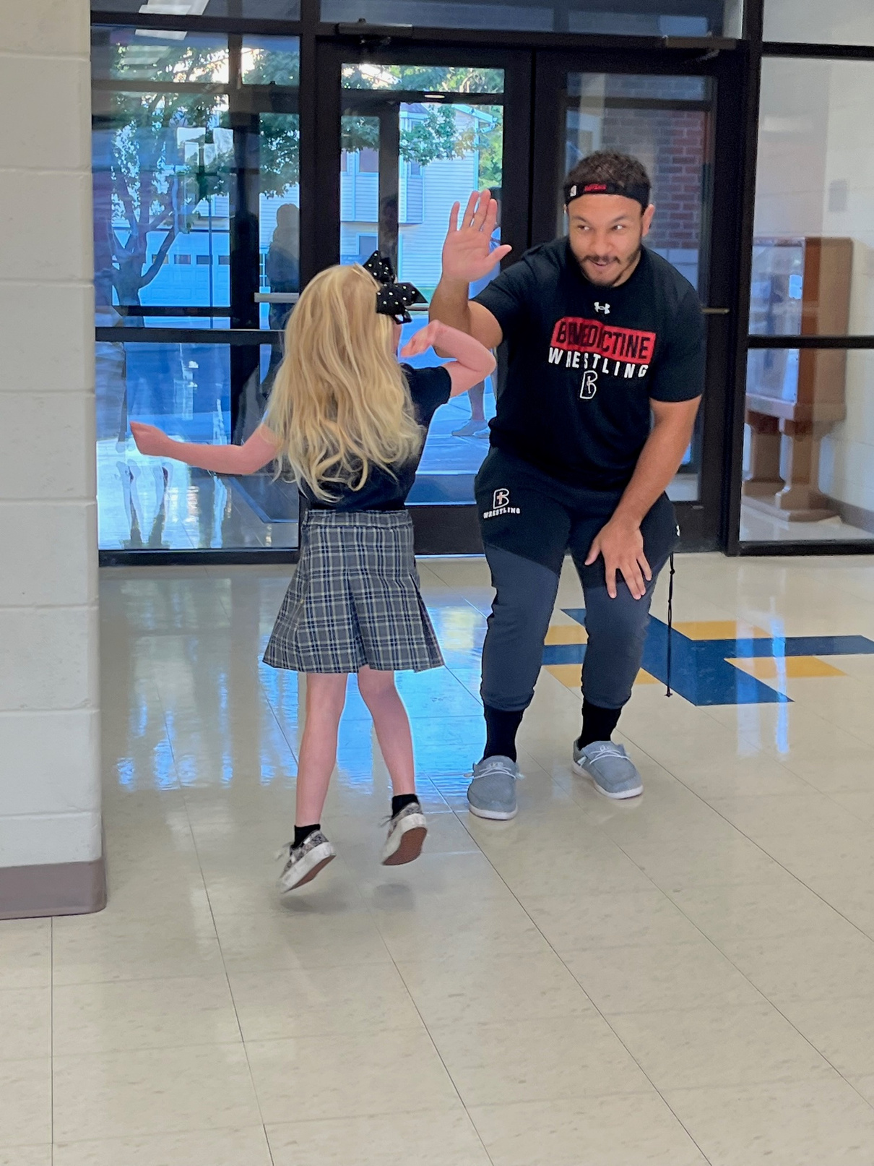
TEAMING UP FOR CHARACTER
Championship Events
Teaming Up for Character activities are an integral part of every NAIA Championship annually impacting more than 30,000 youth across the country annually.
Notes:
Champions of Character® connects communities and NAIA Championships across the U.S.
Championship hosts are free to choose the Champions of Character activity that best fits their championship and community.
Teaming Up For Character events and NAIA Championships are designed to promote the five-core
values of Integrity, Respect, Responsibility, Sportsmanship and Servant Leadership to local youth in
your community. NAIA student-athletes will interact with elementary school, middle school or youth
organizations through school visits or sport clinics to deliver the Champions of Character message.

Slide 16
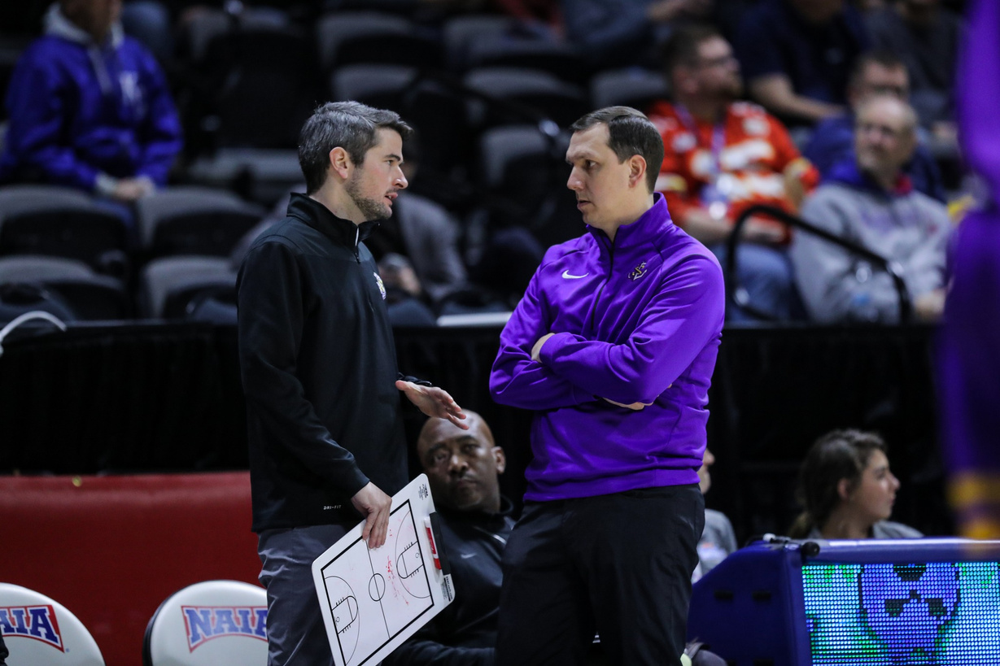
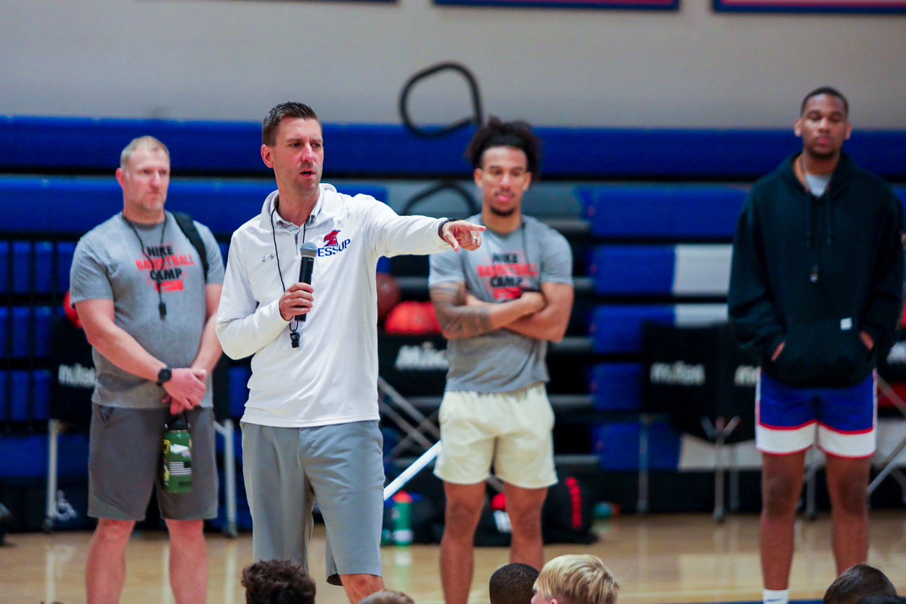
COACH OF CHARACTER TRAINING
Required for all new coaches
  The NAIA's Character-Driven Coaching Course is the ONLY coaches character training in collegiate sports.
  Within sixty days of being hired or joining the NAIA, each coach must complete this learning module and become certified in Character-Driven Coaching
Notes:
Coaches have an overwhelming influence in shaping the lives of the more than 83,000 NAIA student-athletes. With that influence comes an obligation to develop each student-athlete in line with the NAIA’s Five Core Values–integrity, respect, responsibility, sportsmanship, and servant leadership.

Slide 17
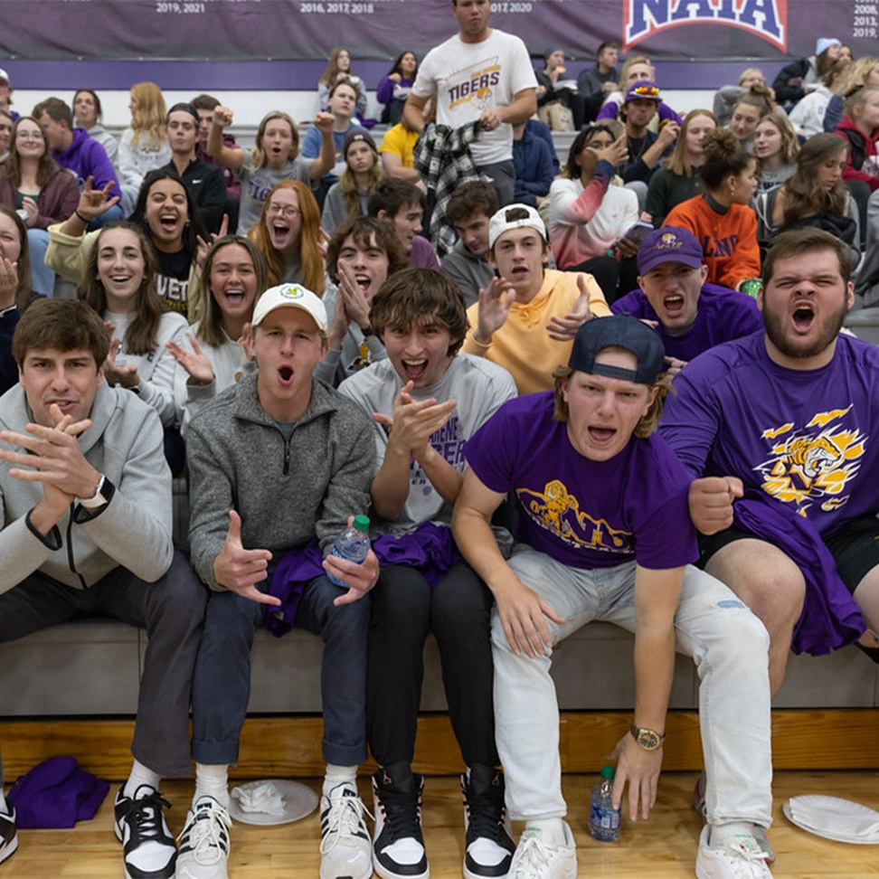
CONDUCT IN COMPETITION
Hospitality & Game Management Of conference athletics events including conduct in competition
  Set and communicate expectations for hospitality and game management.
  Establish procedures for responding to extreme behavior, including a crisis management plan.
Notes:
Hospitality and Game Management: Conduct in Competition
a. Oversee athletic events including Conduct in Competition Guide
b.Conduct contests according to the NAIA’s standard for game management
c. Use NAIA resources to promote your Champions of Character program prior to and during the event.
d. Use the PA announcements at the start of each contest.

Slide 18

CALL TO ACTION
Administrators: Foster procedures that provide a positive atmosphere, an attitude of sportsmanship, and a safe expereience for all students, athletes, officials, and spectators.
Coaches: Intentionally define, model, shape, and reinforce the 5 Core Values through your own coaching and mentoring.
Student-Athletes: Learn, value and understand how Champions of Character can play out in practice, competition and in life.

Slide 19
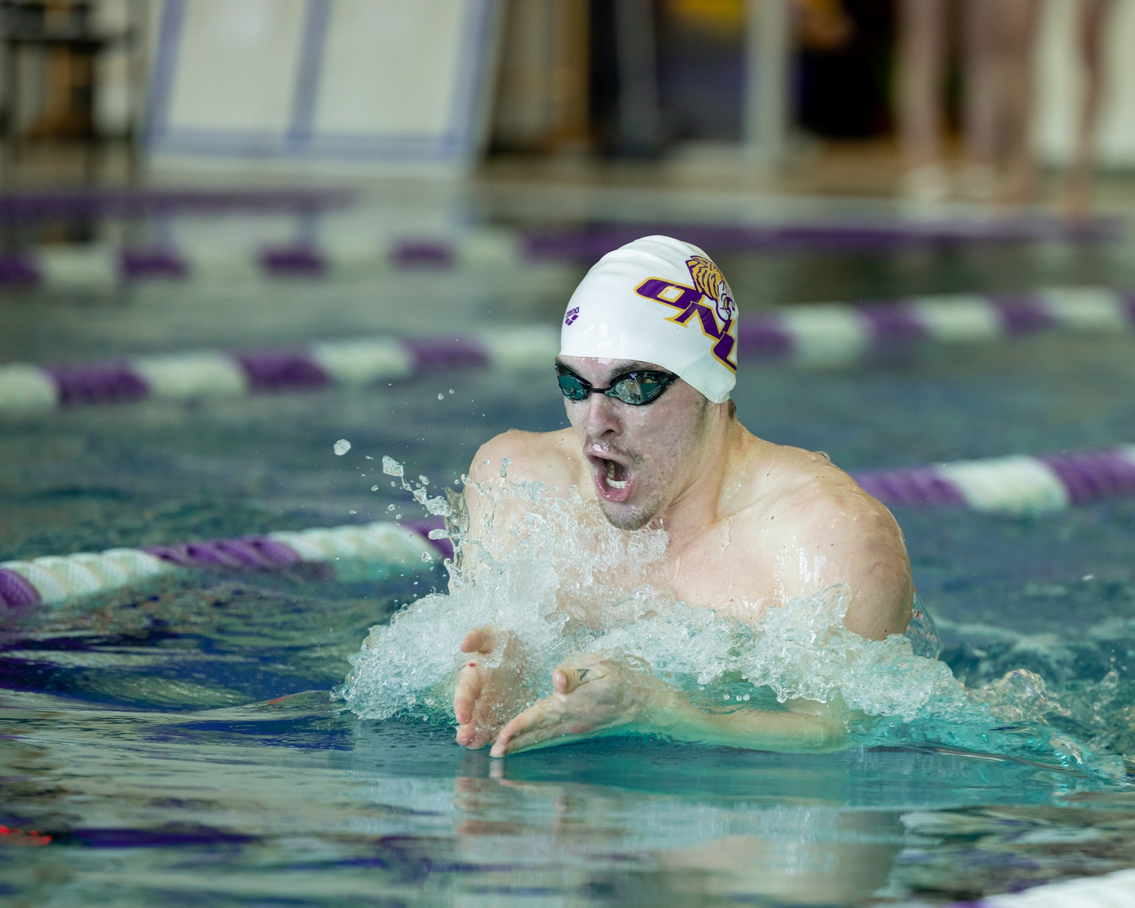
QUESTIONS?

