Slide 1
NAIA National Championship
Drug Testing Education

Slide 2

Performance Enhancing Drugs (PED)
The NAIA tests for PEDs at National Championship and Invitational competitions.
Drug Free Sport (DFS) AXIS
Each institution’s Head Athletic Trainer, Head Coach, and Strength Coach has access to the list of NAIA banned substance categories.
Awareness
Make these individuals aware if you are currently taking/planning to take any prescription medication, dietary supplements, or other substances.
Notes:
Banned Substance List: https://www.naia.org/drug-education-testing/files/NAIA_Banned_Substances_List_2024-25.pdf
Login Portal to AXIS: https://www.axis.drugfreesport.com/login
AXIS Password: naialive5

Slide 3
HIPAA
If you are hesitant to disclose your prescriptions, please know this law prohibits campus administrators from discussing your medical records with people who do not have a legitimate interest to know.
Documented Diagnosis
Some medications may have been prescribed for behavioral, emotional, or educational purposes.
Accommodations
Sharing your diagnosis and prescription with your institution’s office that handles disability support services might help you secure resources or accommodations in your classes.
Notes:
HIPAA protects student-athletes when they disclose their medical information. They can rest assured that it is protected along with their documented diagnoses that may require the medication. Sharing this information with the appropriate offices at your institution may gain academic support and resources for your student-athletes to help them be more successful.

Slide 4
  Stimulants
  Anabolic Agents
  Diuretics and Masking Agents
  Peptide Hormones and Analogues
  Anti-estrogens
  Beta-2 Antagonists
  Examples provided in AXIS
  Blood Doping
  Local Anesthetics (under some conditions)
  Manipulation of Urine Samples
  Beta-2 Antagonists (permitted only by prescription and inhalation)
  Caffeine (if concentrations in urine > 15 micrograms/ml)
  Dietary supplements (DS) w/ vitamins and minerals are unregulated
  Some DS are contaminated w/ banned substances not listed on bottle
  DS have caused positive results and loss of eligibility
  Products w/ DS ingredients are taken at your own risk
Banned Classes of Drugs
Drugs & Procedures Subject to Restrictions
Nutritional & Dietary Supplements
Notes:
The above includes a breakdown of information from the banned substances list (BSL) and their class type. The NAIA BSL lists examples of each class so student-athletes are clear on what may cause a positive test.

Slide 5
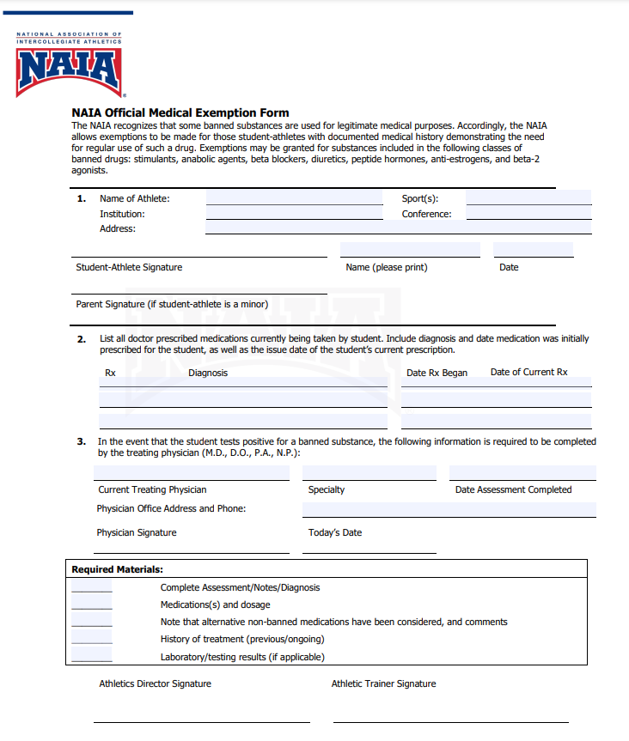
If you are prescribed a medication that will cause a positive test, you can complete a Medical Exemption Form.
Locate the form in the Student-Athlete Wellness Center under Body at the Core.
We recommend working with your AT as soon as you can to submit your information!
Notes:
We understand that there will be times that SA’s have legitimate prescriptions that would cause a positive test. There is a protocol that an SA and ATC can complete to ensure that this is properly documented in the event that the SA is drug tested and their medication results in a positive test. The sooner the SA works on this with the ATC in advance, the better! Find the form here -- https://www.naia.org/drug-education-testing/files/Medical_Exemption_Fillable_Form-_APPROVED_4.22.24.pdf

Slide 6
Consequences of a Positive Test
First Offense:
A. Immediately suspended in all sports
B. Suspension lasts at least 365 days
C. Loss of additional season, beyond current season
Second Offense:
A. Loss of all remaining eligibility in all sports
Important Notice:
No-shows or refusals to test will be treated as a positive result.
Important Notice:
If seniors take advantage of the testing protocol at championships, it could result in probation of the program.

Slide 7
Inform your Head AT, strength coach, and sport coach about any medications you are currently taking.
Get approval before starting any new medication and discuss any supplements or vitamins.
Notes:
AXIS provides a portal to inquire about certain brands of medications, supplements, and vitamins and the likelihood of a positive test based on their known ingredients. We recommend that if there is any level of uncertainty about any of the above, work with the ATC and utilize AXIS.

Slide 8

: for Student-Athletes
Notes:
https://www.youtube.com/watch?v=AAMiqC40cPU

Slide 9

: for Administrators
Notes:
https://www.youtube.com/watch?v=cXXotY-mPV8

Slide 10
Institutional Drug Testing Policy
Enter text
Notes:
Use this slide however you like to introduce your institutional policies related to drug testing & education

Slide 11
Institutional Policy (continued)
Enter text
Notes:
This is an additional slide to use for your own institutional policies related to drug testing & education

